Slide 1
Machine Learning
Classification of Vulnerabilities (CVE) Using AI/Machine Learning

Slide 2

Introduction
Vulnerability
An instance of one or more weaknesses in a Product that can be exploited, causing a negative impact to confidentiality, integrity, or availability; a set of conditions or behaviors that allows the violation of an explicit or implicit security policy.
Goal:
Develop a machine learning model to classify CVEs(Common Vulnerabilities and Exposures) based on their descriptions.
Automate the analysis of CVEs, helping security teams prioritize and respond to vulnerabilities more effectively.

Slide 3
Introduction(CONT…)
Overview of CVE (Common Vulnerabilities and Exposures):
What is CVE?
A database of publicly known security vulnerabilities.
A repository of publicly disclosed information security vulnerabilities such as CVE Details and NVD (National Vulnerability Database).
Managed by the MITRE Corporation.
Importance of CVE classification:
Helps organizations prioritize and manage vulnerabilities.
Focuses on automating the classification process using AI/ML. In other , we can say that it Saves time and resources with automation.

Slide 4
Problem Statement
Security vulnerabilities are increasing, requiring efficient categorization System.
Manual classification is time-consuming and error-prone.
Need for a machine learning-based approach to automate and improve classification accuracy.

Slide 5
Objectives
Build a dataset from CVE sources.
Extract and preprocess data for machine learning.
Develop and evaluate models to classify vulnerabilities into categories: critical, high, medium, and low.
Provide actionable insights for vulnerability management.

Slide 6
Dataset
Source: CVE Details and National Vulnerability Database (NVD).
Key Attributes:
CVE ID: Unique identifier.
Severity: Critical, High, Medium, Low.
Description: Text summarizing the vulnerability.
CWE-ID: Common Weakness Enumeration ID.
Total Data:
Vulnerabilities spanning 2024.(CVE-2024-12002)

Slide 7
Methodology
Data Collection: Extract data from CVE repositories.
Preprocessing: Clean data, tokenize descriptions, and label severity.
Model Training: Apply algorithms like Random Forest, ANN, and CNN(Convolutional Neural Networks).
Evaluation: Measure accuracy, precision, and recall.
Visualization: Present results with graphs and charts.

Slide 8
Methodology(Cont..)
Step 1: Collection of data from various databases like, CVE Details & NVD(NIST)
1
Step 2: Creation of dataset from collected data
2
Step 3: Data preprocessing & Feature extraction
3
Step 4: Data labelling
4
Step 5: Apply Random Forest and Neural Network algorithm(CNN & ANN)
5
Step 6: Determine performance measurement of model
6
Step 7: Graph construction
7
Step 8: Create an interface using COM to generate an alert
8
Step 9: If software is vulnerable then alert will be generated
9

Slide 9
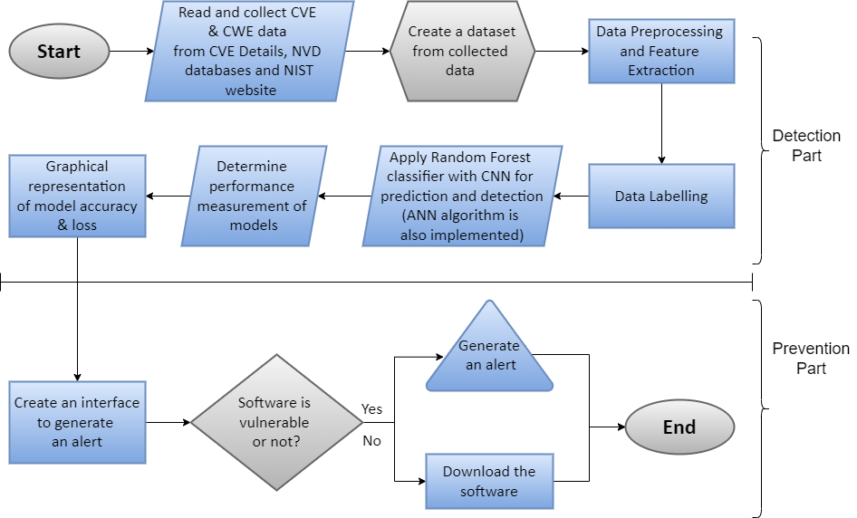

Slide 10
Implementation
Technologies and Software used for implementation of proposed work:
Programming Language | Python
Technology | Machine Learning and Deep Learning
Algorithm | Random Forest, Neural Network Algorithms(ANN(Artificial Neural Networks ) & CNN(Convolutional Neural Networks))
Software | Windows Powershell for Prevention
Online Platform for Coding | Google Colab
Dataset | CVE-2024-12002
Library | scscikit-learn, TensorFlow, Keras, Pandas, Matplotlib

Slide 11
System Requirement
Hardware:
Intel Core processor, 8GB RAM, NVIDIA GeForce GPU.
Software:
Python 3 with TensorFlow, scikit-learn.
Google Colaboratory for cloud-based execution.
Why Google Colab?
Free cloud GPU access for machine learning experiments.

Slide 12
Algorithms Used
Random Forest: For initial baseline classification.
Artificial Neural Networks (ANN): For improved accuracy in text processing.
Convolutional Neural Networks (CNN): For capturing patterns in textual data.

Slide 13

Random Forest: For Initial Baseline Classification
Why Random Forest?
Random Forest is a robust ensemble learning algorithm that combines multiple decision trees to make accurate predictions.
It is computationally efficient, making it an excellent choice for quickly establishing a baseline performance.
It handles high-dimensional data well, which is useful for datasets with multiple attributes, such as CVE data.
Purpose in the Project:
To provide a baseline classification model to compare the performance of more advanced models like ANN and CNN.
It acts as a control model to assess whether deep learning models significantly outperform traditional machine learning methods.

Slide 14

Artificial Neural Networks (ANN): For Improved Accuracy in Text Processing
Why ANN?
ANN is a powerful machine learning algorithm inspired by the human brain, capable of capturing complex patterns and relationships in data.
It is particularly effective for numerical and categorical data as well as structured textual data.
By adjusting weights during training, ANN learns to make predictions with higher accuracy than traditional algorithms for large, intricate datasets.
Purpose in the Project:
To improve classification accuracy for textual and numerical data in the CVE dataset.
ANN is used to process pre-tokenized descriptions and severity labels, leveraging its ability to detect subtle patterns in the dataset.

Slide 15
Convolutional Neural Networks (CNN): For Capturing Patterns in Textual Data
Why CNN?
CNNs are typically used for image recognition but have proven effective for natural language processing (NLP) tasks when applied to textual data.
CNNs excel at detecting local patterns or features in sequences, which is useful for analyzing vulnerability descriptions (e.g., detecting keywords or common phrases indicative of severity).
They use convolutional layers to extract contextual meaning from text, which helps in fine-grained classification tasks.
Purpose in the Project:
To capture local dependencies and patterns in vulnerability descriptions more effectively than ANN.
To enhance performance on unstructured textual data, as CNNs can automatically identify significant features in descriptions that indicate severity levels.

Slide 16
Why These Models Were Chosen
Random Forest establishes a baseline for comparison.
ANN improves overall accuracy and handles structured textual and categorical data efficiently.
CNN focuses on pattern recognition in unstructured textual data, offering a deeper understanding of vulnerability descriptions.

Slide 17
Results
Model Performance:
Random Forest, ANN, and CNN evaluated based on accuracy, precision, recall, and F1 score.
Model Inference Example:
Prediction of vulnerability class using Random Forest on sample descriptions.
Accuracy Comparison (Graph):
Accuracy of ANN vs CNN vs Random Forest (display in graph).

Slide 18
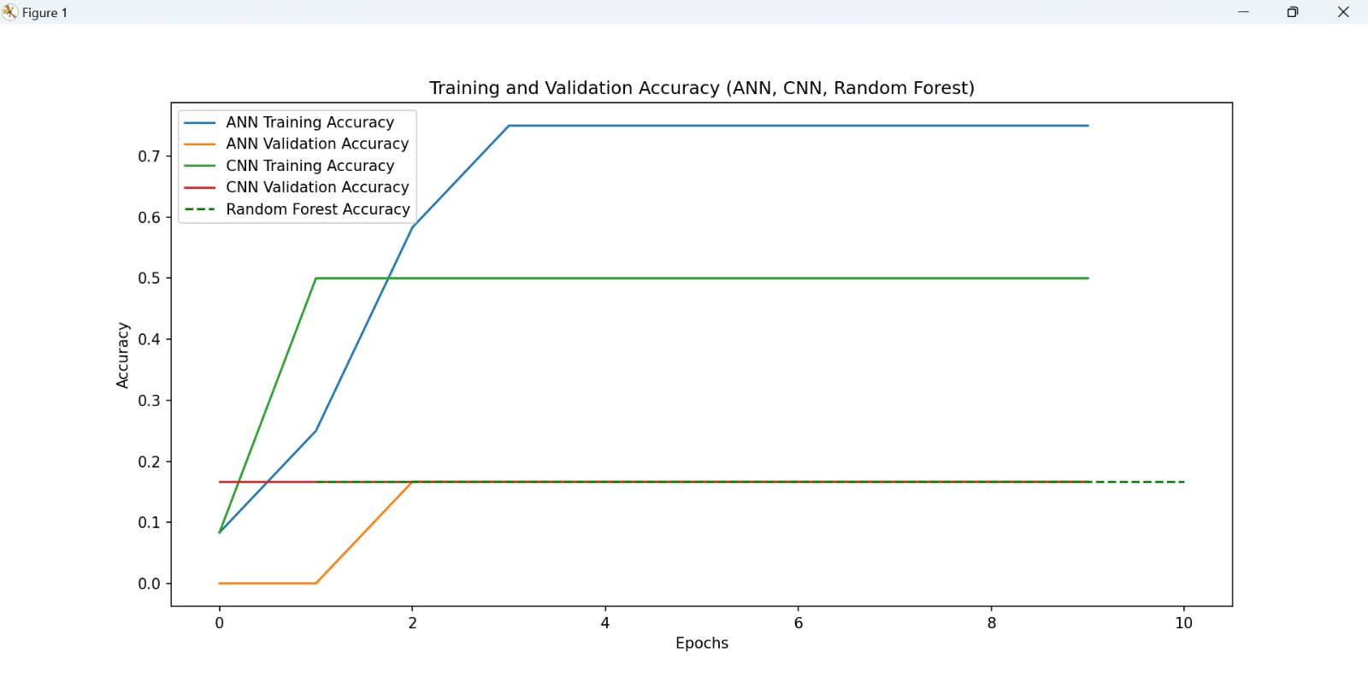
Accuracy Comparison (Graph)

Slide 19
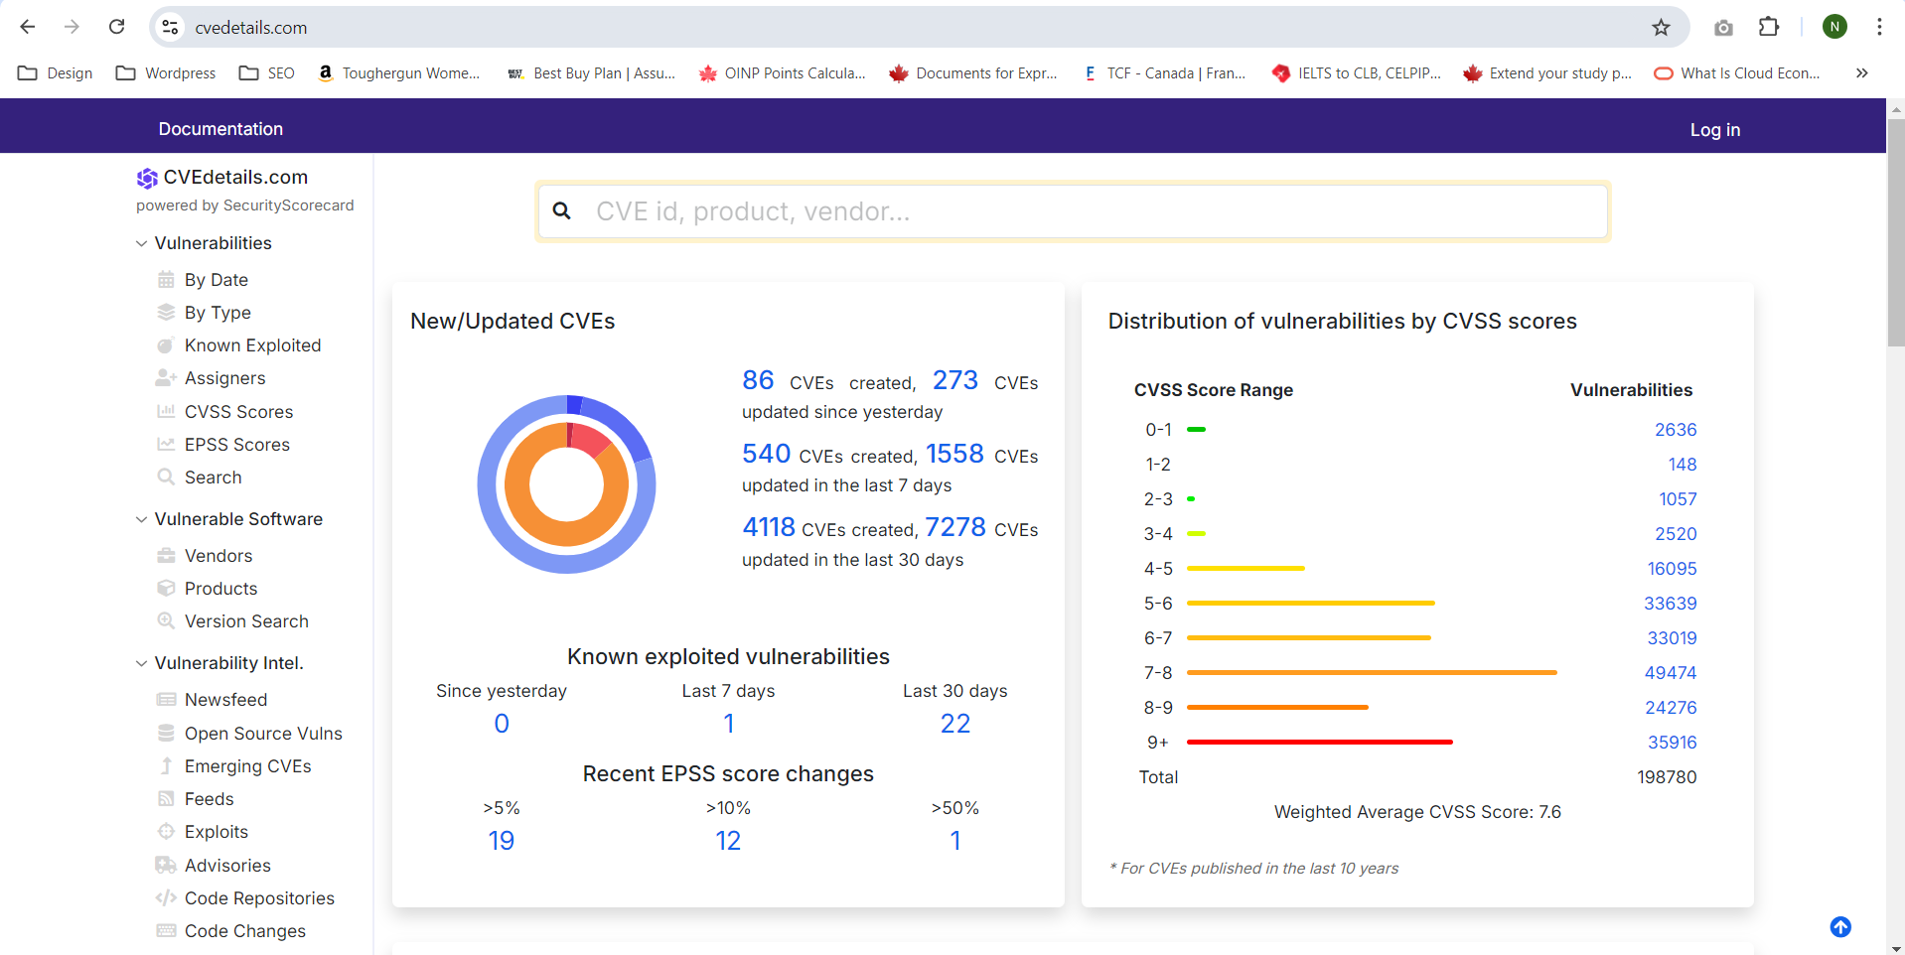
DATASET

Slide 20
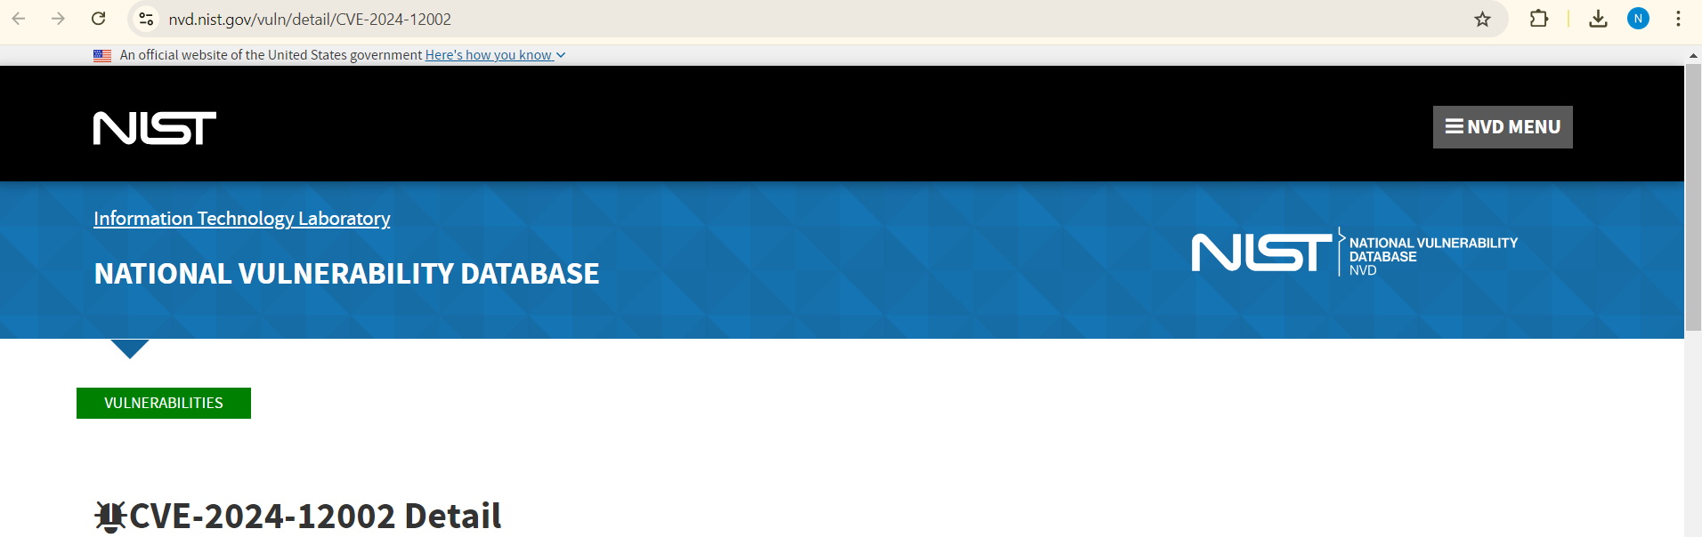
Dataset(CONT…)

Slide 21
Conclusion
Achieved an automated model for CVE classification.
Improved vulnerability management.
Enhanced decision-making for security teams.

Slide 22
References
CVE Details :
Official website: https://www.cvedetails.com/
National Vulnerability Database (NVD)
Official website: https://nvd.nist.gov/
Serena Elisa Ponta, Henrik Plate, Antonino Sabetta.
“Detection, Assessment, and Mitigation of Vulnerabilities in Open Source Dependencies.” Springer, 2020.
https://realpython.com/python-keras-text-classification/

Slide 23
References(Cont…)
Grzegorz Siewruk, Wojciech Mazurczyk.
“Context-Aware Software Vulnerability Classification Using Machine Learning.” IEEE, 2021.
Rebecca L. Russell, Louis Kim, Lei H. Hamilton, Tomo Lazovich.
“Automated Vulnerability Detection in Source Code Using Deep Representation Learning.” IEEE, 2018.

Slide 24


